Slide 1
Hyper Personalization & Recommendation
Code Crusaders:
Albert, Vijay
Kandachar, Gururaja
Krishnan, Vikas C

Slide 2
Introduction
Overview:
AI-driven predictive insights,
Personalization and
Sentiment analysis
Role of LLaMA2 and Mistral 7B in enabling these capabilities

Slide 3
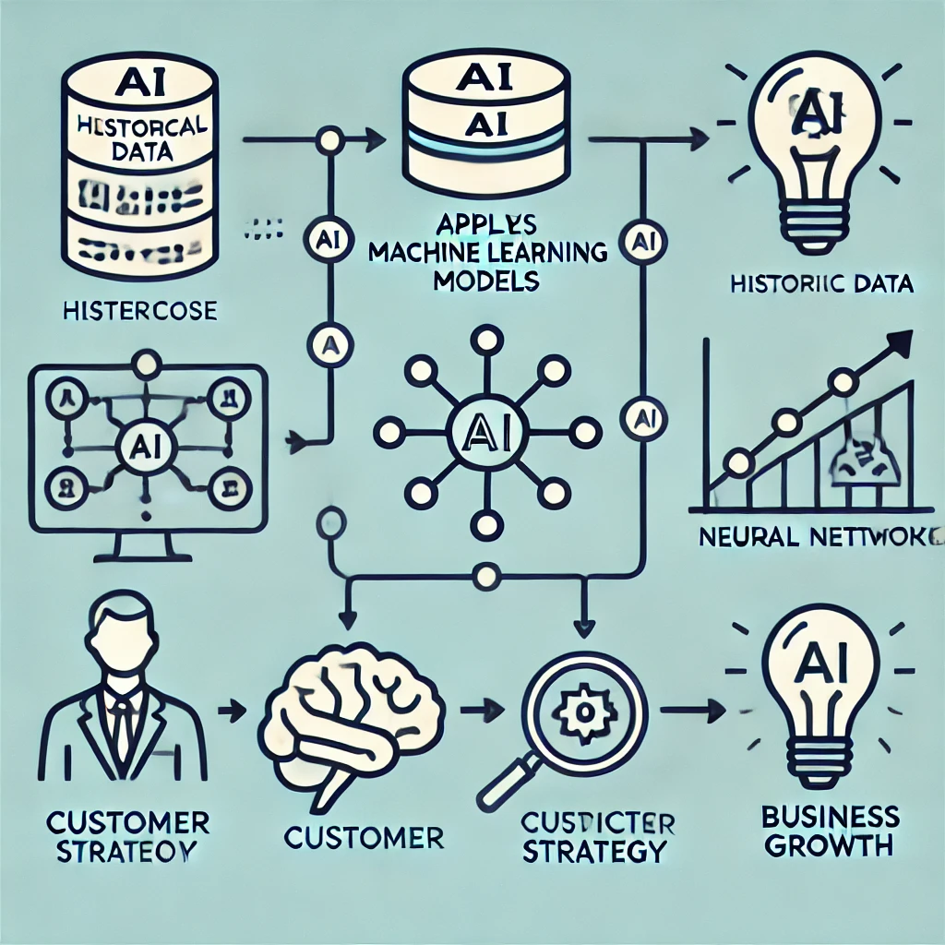
Predictive Customer Insights & Business Strategies
AI models analyze customer behavior and predict trends
Example: Forecasting product demand or churn rate

Slide 4
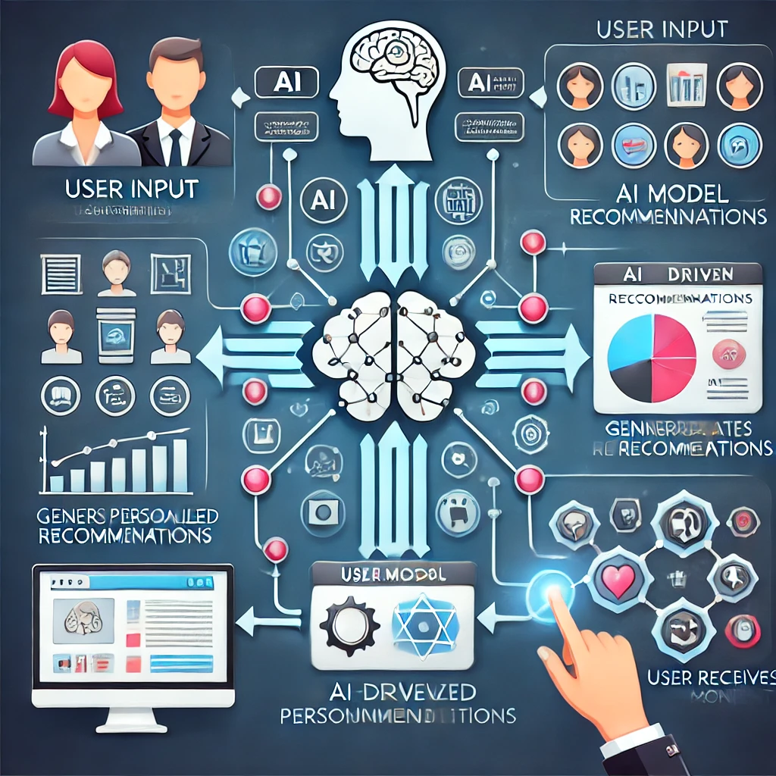
Multi-Modal Personalization
Combining text, image, and behavioral data for customized experiences
Real-world applications: E-commerce, financial services

Slide 5
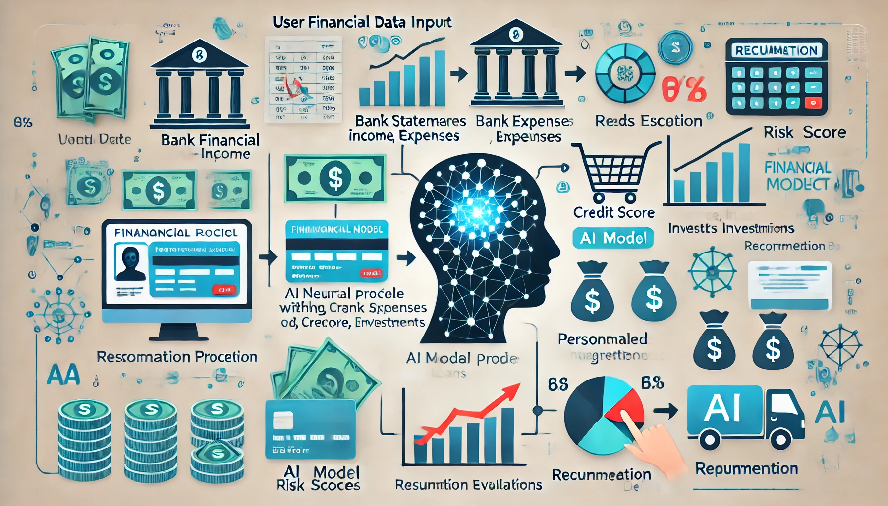
Hyper-Personalized Financial Product Recommendation
AI-driven analysis of customer financial profiles
Use cases: Loan approvals, investment recommendations

Slide 6
Sentiment Analysis
AI extracts sentiment from customer reviews, social media, and support tickets
Helps in brand reputation management and proactive service
Collect Text Data/Input
Preprocess + Analyze Sentiment
Classify Sentiment
Generate Actionable Insights

Slide 7
Ethical AI, Data Privacy, & Compliance
Key aspects:
Consent management
Fairness
Transparency & Explainability
Bias mitigation

Slide 8
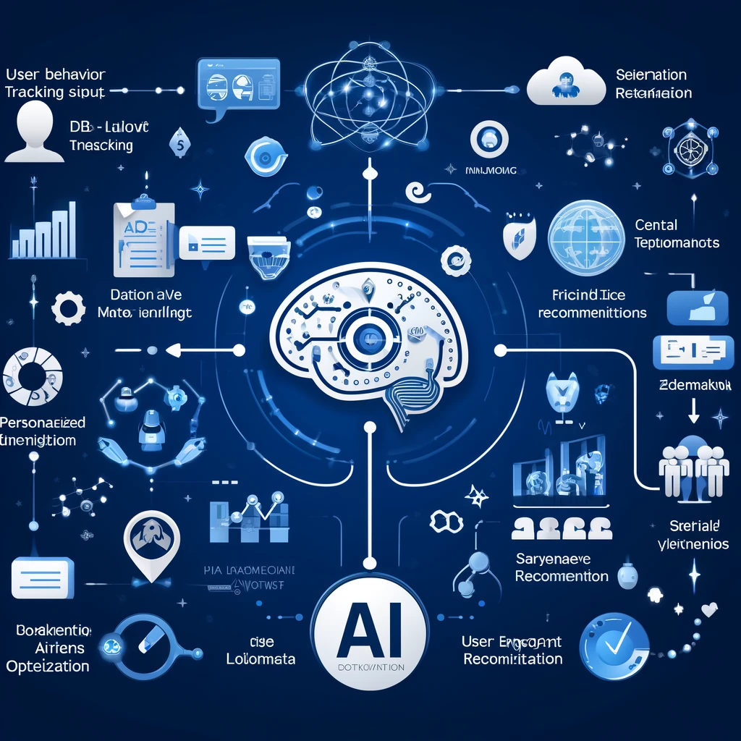
AI-Driven Recommendations for Engagement & Optimization
Personalized marketing strategies
AI-powered chatbots and automation

Slide 9
Reinforcement Learning & Advanced Prompt Engineering
Role of RLHF (Reinforcement Learning from Human Feedback) in
Enhancing AI model accuracy by refining responses based on user interactions and feedback,
Reducing biases, and
Improving adaptability to complex queries
Advanced prompt engineering strategies to enhance
Response relevance,
Coherence, and
Contextual understanding
Applications:
Fraud detection,
Credit scoring,
Personalized recommendations, and
Demand forecasting for financial and retail businesses

Slide 10
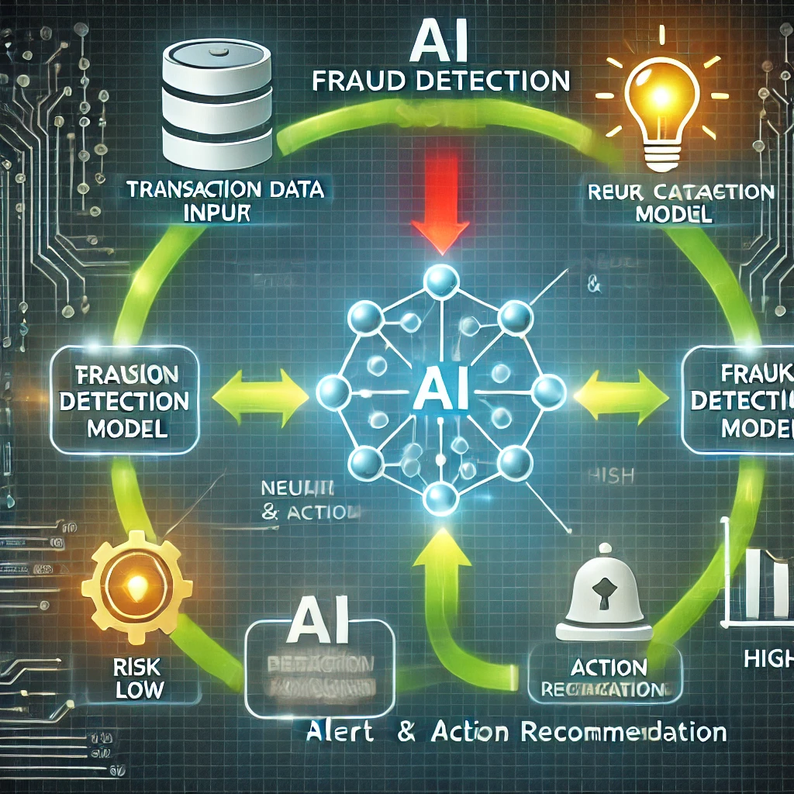
Automated Risk Assessment & Fraud Detection
Detecting suspicious transactions using AI
Financial security measures
Fraud prevention strategies

Slide 11
Summary
AI-driven predictive insights optimize customer engagement, business strategies, and risk assessment.
Multi-modal personalization leverages text, images, and behavioural data to tailor user experiences.
Hyper-personalized financial recommendations improve customer satisfaction and financial decision-making.
Sentiment analysis aids in brand reputation management and proactive service enhancements.
Ethical AI principles, data privacy, and compliance are crucial for responsible AI deployment.
AI-driven engagement strategies enhance marketing, product discovery, and customer interactions.
Reinforcement learning and advanced prompt engineering improve AI accuracy and adaptability.
Automated risk assessment detects fraudulent transactions and enhances financial security.
The integration of LLaMA2 and Mistral 7B provides scalable AI-driven solutions.

Slide 12
Demo
Run the model
Access the APIs exposed via Postman
View model response

Slide 13
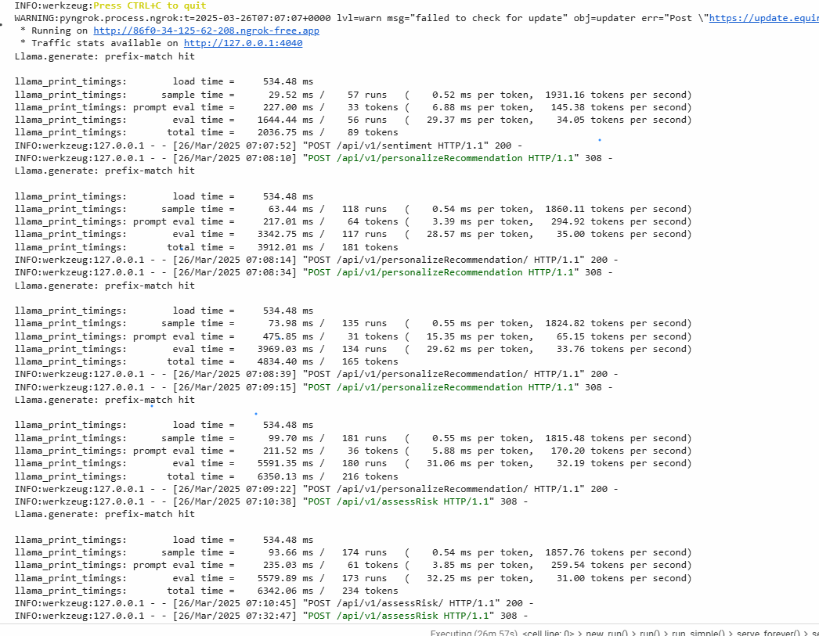
Demo snapshots

Slide 14
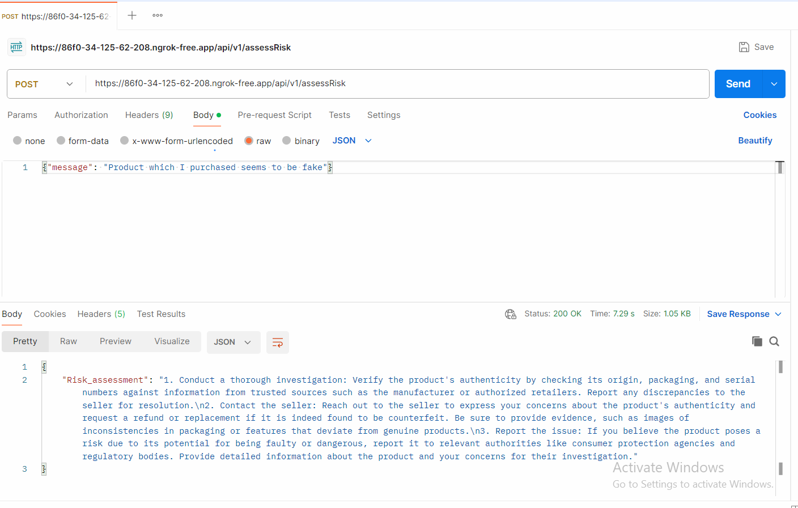
Post man execution snapshot

Slide 15
Reference
Research Papers & Case Studies:
AI-Driven Predictive Analytics in CRM
Harnessing AI for Customer Retention
Predictive Analytics for Market Trends
Artificial Intelligence & Predictive Marketing
AI for Personalized Marketing
AI Integration in Salesforce
Predictive Models for Reducing Customer Churn
AI in Retail Predictive Analytics
Model Documentation:
Mistral 7B Documentation
LLaMA 2 Documentation

